Slide 1
Web Community Manager Accessibility Online Training Today’s Trainer: Kit Archie

Slide 2
Disclaimer
The information in this presentation was prepared for informational purposes only. The information contained herein is not intended to constitute legal advice and you should consult with your own attorney when developing your online accessibility program and policy. Blackboard assumes no liability in connection to this presentation and any information contained herein.

Slide 3
At the end of today’s hands-on workshop you will be able to:
Define accessibility and its importance.
Set up a Page
Format text with Headings
Create Accessible links
Create Alternative tags for images
Understand how and when to use color
Create Accessible documents
Understand how tables interact with screen readers
Understand the different video caption types
Find Helpful Materials for compliance and accessibility errors

Slide 4
What is Accessibility?
Accessibility defined
Examples of Accessibility:
Ramps
Interpreters
Text on a website
Goal of Accessibility

Slide 5
Electronic Information and Accessibility
Web accessibility defined
Creating accessible electronic information
Why should we focus on website accessibility?

Slide 6
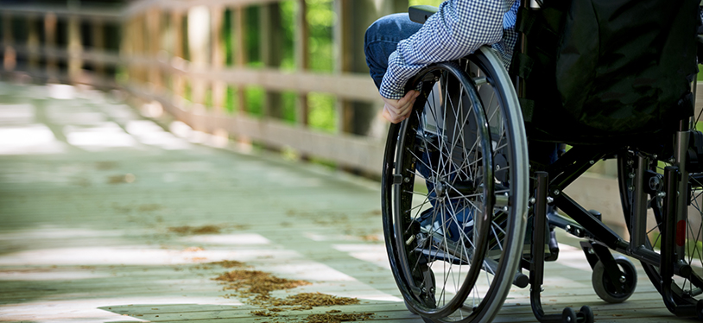
Blackboard & Accessibility
Blackboard’s Accessibility program is being built on the following core beliefs, which provide guidance for achieving program goals and objectives
Accessibility is an imperative, not an afterthought.
Understand, empathize, and act.
Deliver the promise.

Slide 7
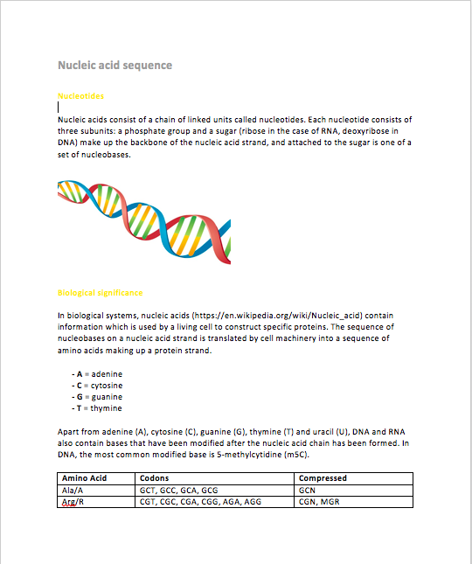
Screen Reader Activity Part 1
Activity can also be found
by clicking HERE.

Slide 8
Screen Reader Activity Part 2
Nucleic acid sequence
Nucleotides Nucleic acids consist of a chain of linked units called nucleotides. Each nucleotide consists of three subunits: a phosphate group and a sugar (ribose in the case of RNA, deoxyribose in DNA) make up the backbone of the nucleic acid strand, and attached to the sugar is one of a set of nucleobases. Biological significance In biological systems, nucleic acids contain information which is used by a living cell to construct specific proteins. The sequence of nucleobases on a nucleic acid strand is translated by cell machinery into a sequence of amino acids making up a protein strand. A = adenine C = cytosine G = guanine T = thymine
Activity can also be found
by clicking HERE.

Slide 9
Diverse Accessibility Challenges
Cognitive
Visual
ADHD
Dyslexia
Downs Syndrome
Difficulty concentrating
Difficulty reasoning and understanding
Poor comprehension
Low/poor vision
Color blindness
Total blindness
Difficulty seeing contrasts
Seizure sensitivity
Physical
Hearing
Lost Limbs
Poor gross/fine motor controls such as Muscular Dystrophy
Difficulty communicating struggles
Partial/full paralysis
Limited Hearing
Complete deafness
Difficulty taking notes & reading captions at same time

Slide 10
A Few Common Issues
Improper use of headers
Empty links or links without alternative text
Color contrast issues
Using tables incorrectly
Missing alternative text tags in images
Documents that are not built accessibly
Videos without captions

Slide 11
Guidelines for Accessible Web Content
Write Plainly
Utilize a built in heading structure rather than creating your own headings with font styles.
Add alternative descriptions for images and links.
Only use tables for tabular data not display structure.
When creating lists, use the built in list formatting.
Make sure that any documents you upload, link or display on your website are accessible as well before adding them.
Make sure videos that you are embedding include some sort of captioning.

Slide 12
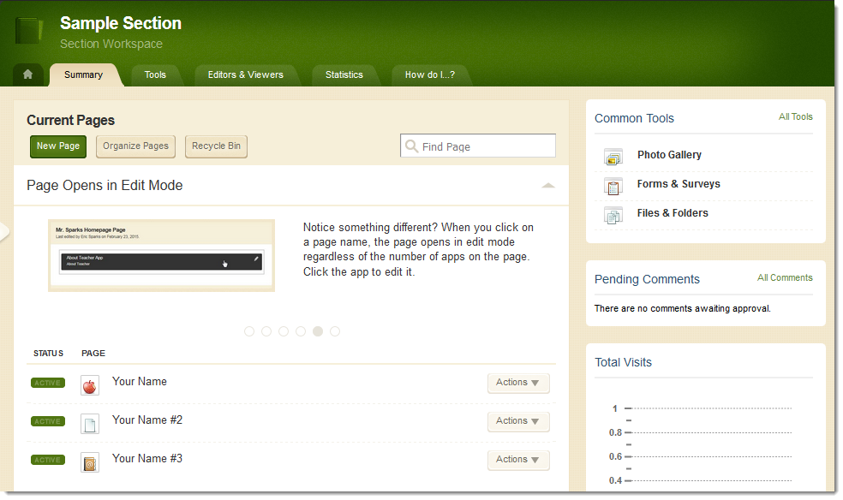
Activity: Build WCM Page with Accessibility in Mind
Sign in to website
Open Site Manager
Navigate on back end of site to a Section Workspace
Build a Blank Page named “Accessibility Practice” (Hit Save and Exit)
Set Page Options to “Hide this page from website navigation”
Click on page name to edit page.
Add Apps to Page
Content App
Shortcuts App
Image App

Slide 13
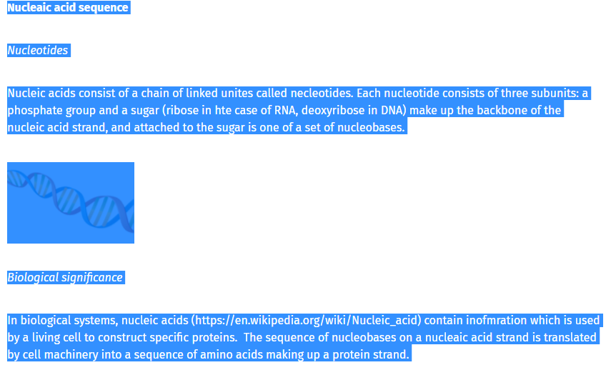
Activity: Content App: Paste as Plain Text
Use the paste as plain text option to add text from the following website into your content app. https://sw00000004.schoolwires.net/accessibility/text

Slide 14
Headings
Why use heading Structure?
Guidelines for Heading Structure:
Keep it logical and consistent
Use built-in heading styles
Don’t use bold, italic, underline, color or font size/style to emulate headings

Slide 15
Activity: Content App: Format text with headings
Use the F & T buttons in the content app to format the text with logical headings.
F button text styles are styles built directly into your template (varies from site to site)
T button text styles are styles that are standard for everyone.
When formatting with these tools always check your page preview to see what they actually look like
H2
H1
H2

Slide 16
Additional Text Formatting For Emphasis
Emphasize text with punctuation rather than font styles
Adding lists is also a great way to emphasize text

Slide 17
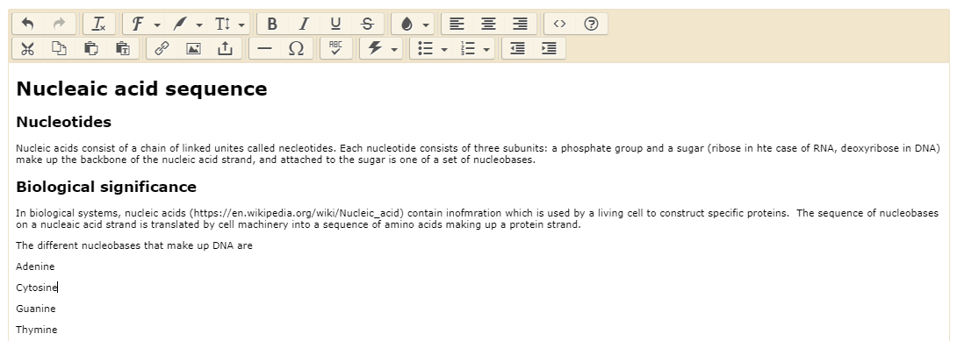
Activity: Content App: Other formatting options
Use punctuation, and the automatic bulleted and numbered list formatting to add additional emphasis to the text in your content app.

Slide 18
Links
Links should be marked up as actual links (do not just list a URL out in plain text)
Making the clickable text on links longer makes them easier to access by people who may have motility issues.
The link should have alt text that describes:
the target (opens in a new window or not)
Context about the link (what it is beyond the URL and name)

Slide 19
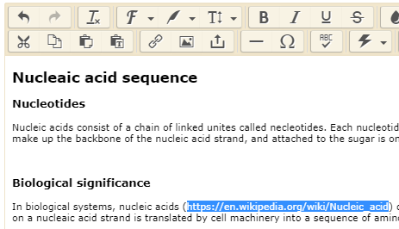
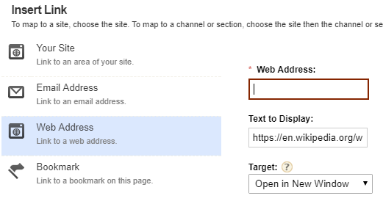
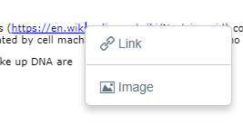
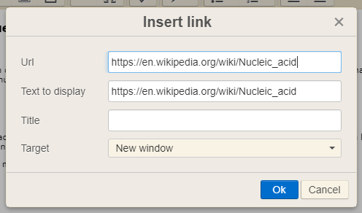
Activity: Content App: Adding links
Copy the link in the second paragraph of the text without the parenthesis https://en.wikipedia.org/wiki/Nucleic_acid
Highlight the link in the text again.
Hit the Insert Link Button.
Choose the option for a “Web Address Link”
Paste copied URL in the Web Address Field.
Double check that your “Text to Display” is correct
Choose a target for your link (open in a new window or the same window)
Hit the “Insert Link” button
After inserting link right click on it and choose the link option from the menu.
Add the alternative text describing your link to the “Title” field. (include context for the link and the target in the alt text).

Slide 20
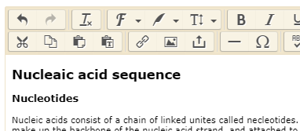
Inserting Accessible Files
There are several ways to add files to your website: (show examples of each/screen shots)
Linking to a file within the content app
Adding a series of files in the file library
Uploading a file into a document viewer app
Before you upload a file in any of these ways you need to be sure that the file itself is accessible, otherwise stakeholders who utilize screen readers will not be able to understand it. (We will discuss guidelines for creating accessible files later on)

Slide 21
Images
When adding an image into any app on your website you need to be sure to add alternative text to describe what that image is.
Alternative Text:
Is essential for students with visual impartments since screen readers and other assistive technologies can’t convert images into words
Facilitates searching
Provides better context

Slide 22
Guidelines for Alt. Text on Images
Text should be clear, concise, and descriptive.
Do not use the same text for every image
Do not add images onto the page that do not go with the provided content.
Decorative text should not be included as part of an image.
If image is an example of something mentioned in the content then the description needs to describe what it is based upon the relationship to the content.
If image is used to provide more information, supplement or accompany content then a comprehensive description that contains all information present in the image and should also include any non decorative text present in the image.
If the image is an infographic you should
Write a narrative telling the same story users get from the visual
Provide a link to view the text alternative

Slide 23
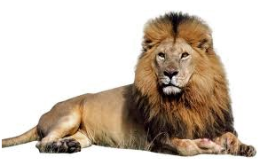
Guidelines for Alt. Text on Images
Alternative Text = Cat
☒
Alternative Text = Male Lion
☑

Slide 24
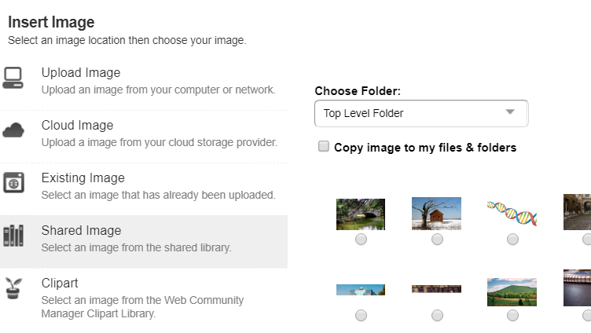
Activity: Content App: Adding Image
Place your curser where you want the image to go.
Hit the insert image button
Select the shared image option.
Choose the image that goes along with the article from the shared image library.
Hit “Continue”
Add alternative text describing the image:
DNA molecule strand showing double helix structure with deoxyribose and nucleobases.
Select alignment as default for this image (no text wrapping)
Add 1 pixel border.
Hit “Insert Image” button.

Slide 25
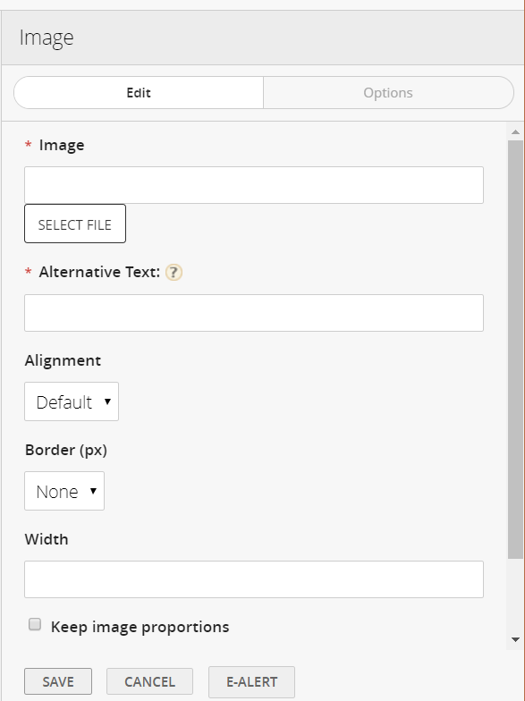
Activity: Image App
Save and exit content app if you haven’t already.
Find the image app on your page (the icon looks like a picture with mountains and sun).
Hover over the image app to see editing choices. Select the green pencil.
Editing Options will appear to the right.
Add image from shared library by clicking on “Select File” button
Add alternative text describing image.
Hit “Save”.

Slide 26
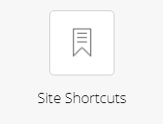
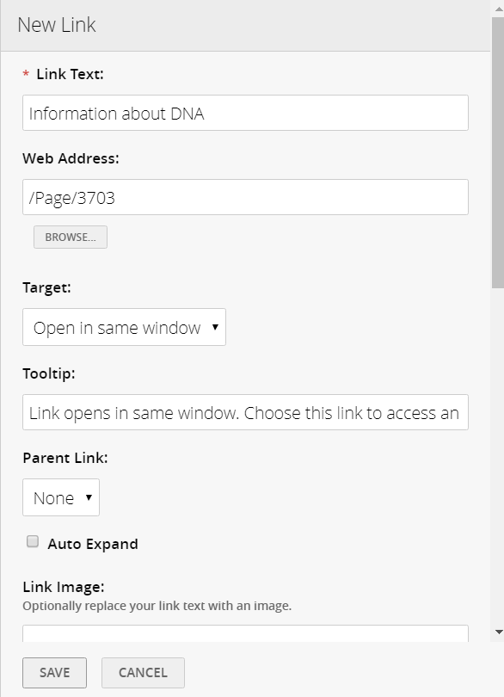
Activity: Site Shortcuts Link
Save and exit image if you haven’t already.
Find the site shortcuts app on your page (the icon looks like a bookmark).
Hover over the site shortcuts app to see editing choices. Select the Green Plus Sign.
Editing Options will appear to the right.
Add Link Text: Information about DNA
Add Web Address by either pasting or browsing. For this example use the browse button and select the accessibility practice page from the menus.
Choose target for link to open in. In this case choose same window because it’s an internal link.
Add in tooltip describing target and context of link beyond the name and URL.
Hit “Save”.

Slide 27
Tables
When you adding information to your website and want to use a table consider why you are wanting to use a table? If possible use a list to present information (lists are preferred to tables for accessibility) because often table are hard for screen readers to navigate.
However if you must use a table be sure that
You are using the table to present tabular data rather than for formatting purposes
It is easy to make associations between the data you are presenting
You always include column headings (<th>) to make the table easier to read and easier to work through using assistive technologies
You add a table to the WCM using the Table app that way it is also completely responsive and can be easily read on multiple devices

Slide 28
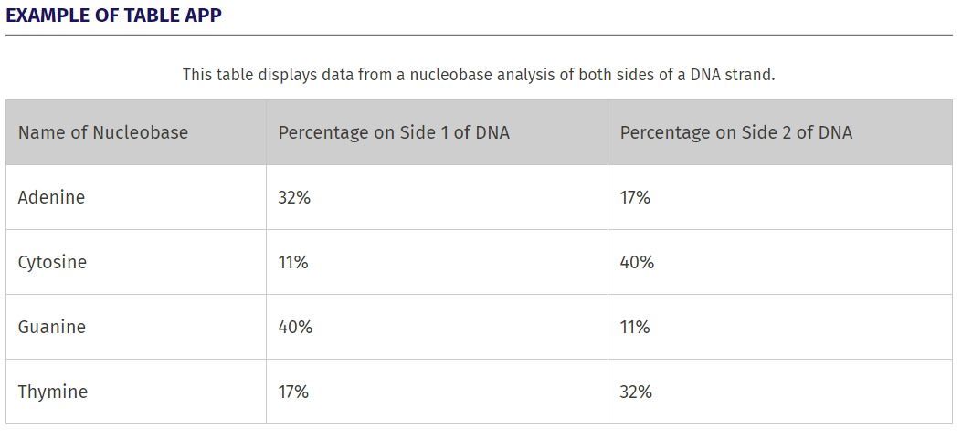
Accessible Table with the Table App
When using the table app always make sure you:
Add in headers for your data and check the appropriate boxes for the types of headers you have added.
Go to the “Edit Table Options” area and choose a “table style” that allows people to easily read the data
Add in a “Table Caption” Under “Edit Table Options” to give brief overview about table. (Shows)
Add in a “Table Summary” Under “Edit Table Options” to help describe data and relationships in table in detail (Doesn’t Show)
Table example lives on: https://sw00000004.schoolwires.net/accessibility/table
Notes:
Mention that caption and summary as well as coloring are added to table in table options.

Slide 29
Alternative Text From Other Apps
Headlines & Features – Alt. Text on Headline Tab.
About the teacher – Name of Person
Booklist – Alt Text on Cover Image Tab.

Slide 30
Formatting accessible Word documents
The exact process for this will be different based upon whatever programs you have.
Structure & Formatting
(Headings, Lists etc.)
Proper use of tables
Alt Text for Images & Links
*Read full article about Formatting Accessible Documents on Blackboard Help

Slide 31
Building accessible PDFs
The exact process for this will be different based on whatever programs you have.
As a note most documents on your website should be formatted as PDFs that way everyone can view them even if they don’t have Microsoft Office etc.
Also scanned PDFs are not accessible, they are essentially just a large image.
Start from a well formatted source file.
Include accessibility tags when saved to PDF.
Invest in Acrobat Pro and use it’s accessibility tools
*Read full article about Formatting Accessible Documents (look for PDF section) on Blackboard Help

Slide 32
Principles of PowerPoint Accessibility
Slide Titles
Reading Order
(Check on this in Outline view)
Alt Text for Images
Self-describing links
*Read full article about the Principles of PowerPoint Accessibility on Blackboard Help

Slide 33
Color & Accessibility
In any sort of content you create color plays a very important role in its accessibility.
Low contrast between text and its background can make content difficult to read for everyone, especially low-vision and colorblind students.
These are some resources to help you analyze and find acceptable levels of color contrast.
Color Contest Analyzer:
https://www.paciellogroup.com/resources/contrastanalyser/
Web-based Color Contrast Analyzers:
WebAim - web accessibility in mind
Accessible Colors

Slide 34
Captioning Videos
Make sure any videos you embed on your site include captioning. Whether that means finding already captioned videos to use or creating your own captioned videos.
Find already captioned videos
To make self captioning easier start with a storyboard
Upload videos to YouTube.
Edit automatic captions on YouTube before posting on your website.
*Read full article about Captioning Video on Blackboard Help

Slide 35
5 Kinds of Captions
Closed Captions are optional; they can be turned on or off with video controls. Videos with closed captions will have double CC icon. If you use closed captions, keep in mind, users who want access to closed captions will need to know how to turn them on, so it is important to include instructions for users.
(Example of CC: https://www.youtube.com/watch?v=7SYnAJg1Cig)
Open Captions are always displayed because it is part of the video stream. Users don't have to know how to turn these captions on.
(Example of Open Captions: https://www.youtube.com/watch?v=eTrkysvC8QA)
Audio Descriptions provide users with sound descriptions, such as "door creaking", and they give a better experience.
(Example of Audio Description: https://www.youtube.com/watch?v=eTrkysvC8QA)
Real-time Captions used for live events or sessions. These services are separate from Blackboard. There is typically a cost for this service and would need to be arranged prior to event or session.
Subtitles translate spoken dialog, usually translated into a different language, and don't include audio descriptions. Subtitles assume that the user can see and here.

Slide 36
Accessibility Checklist
Don’t plan to fix these things afterward. Make them part of your workflow.
Large enough font
Contrast between text and background
Proper heading styles
Logical heading structure
Alt descriptions for images
Tables used for tabular data
Table columns have a column heading
Lists use built-in list functionality
Links have text that describes the target
No scanned PDFs
PDFs are tagged
Built-in PowerPoint slide templates
Add Captioning to videos

Slide 37
Tools and Resources
Helpful links to tools and articles for applying inclusive techniques to your work
Building Content
Microsoft Office
Adobe Acrobat
Bb best practices for accessible content
Hemingway text analyser
Tools for Evaluating
Firefox and Chrome developer toolbars
Wave & Wave Toolbar
AXE Extension
Color contrast checker WebAIM Contrast Checker or Tanaguru Contrast Finder
Your keyboard
Browser magnification (CTRL +/- and CTRL 0)
Keyboard Navigation
Firefox shortcuts
Chrome shortcuts
Google shortcuts
Accessibility in K-12
Blackboard CERC Accessibility help and best practices.
WCAG 2.0 Guidelines
Blackboard’s WCM VPAT
Webinars: Blackboard on Accessibility or Deque Digital Accessibility

Slide 38
In today’s workshop our focus was to help you:
Define accessibility
Set up an Accessible Page
Format text with Headings
Create Accessible links
Create Alternative tags for images
Understand how and when to use color
Create Accessible documents
Understand how tables interact with screen readers
Understand the different video caption types
Find Helpful Materials for compliance and accessibility errors

Slide 39
We hope you’ve enjoyed today’s Workshop.
Let us know how we’re doing!

